Slide 1

www.interra.com.tr

Slide 2

COMMERCIAL AND INDUSTRIAL BUILDING SOLUTIONS
Project Name:
Contact:
Gülşah BALÇIN
İş Geliştirme Mühendisi
gulsah.balcin@interra.com.tr
www.interra.com.tr

Slide 3
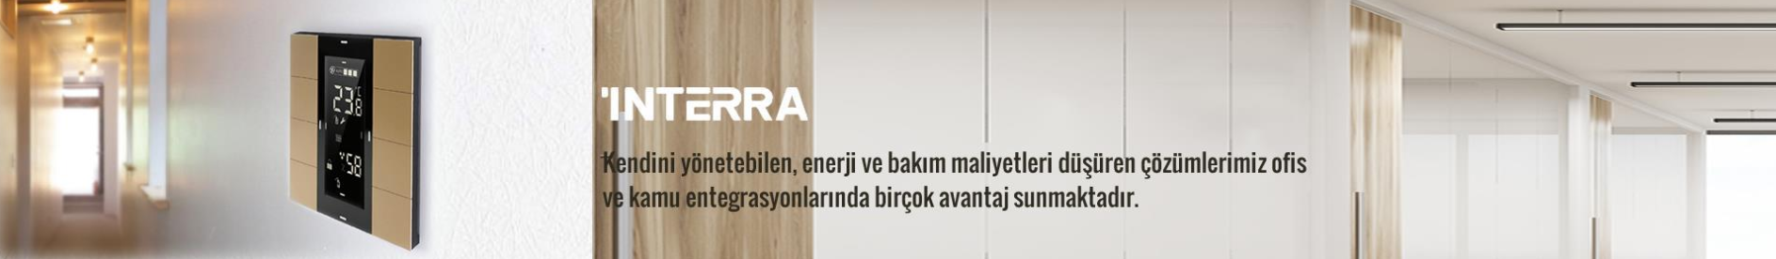






As INTERRA; our main philosophy in the Commercial,Industrial ve Public Project solutionsare also our basic philosophy: self-managed buildings and offices are also full-fledged and environmentally sensitive and special controls and limitations.
Energy saving office-hospital, school-public buildings
Energy Efficiency
Flexibility
Comfort
Security

Slide 4

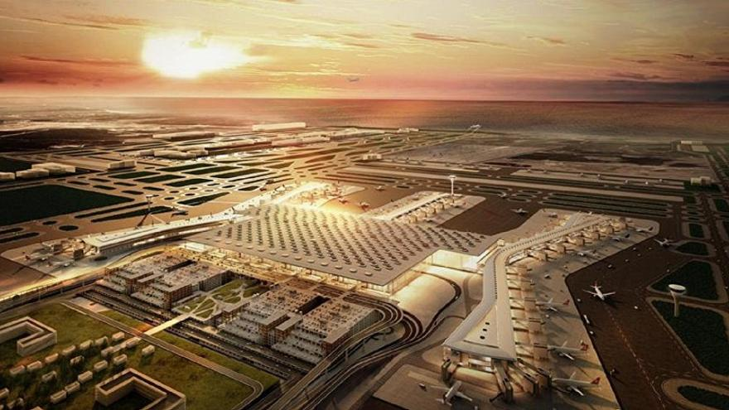
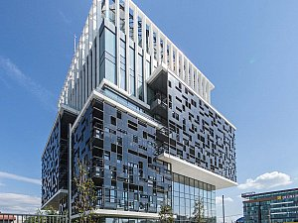
Developer of uniqueness
INTERRA COMMERCIAL AND INDUSTRIAL BUILDING SOLUTIONS
Automation Control
  Scenario
  Lighting Control (On-Off / Dali / DMX)
  Air Conditioning
  Shutter / Blind
  Daylight Controls
  Schedule Controls
Emergency Lighting Reporting
Central Monitoring
Remote Control

Slide 5

AUTOMATION CONTROL
  Scenario
  Lighting Control (On-Off / Dali / DMX)
  Air Conditioning
  Shutter / Blind
  Daylight Controls

Slide 6
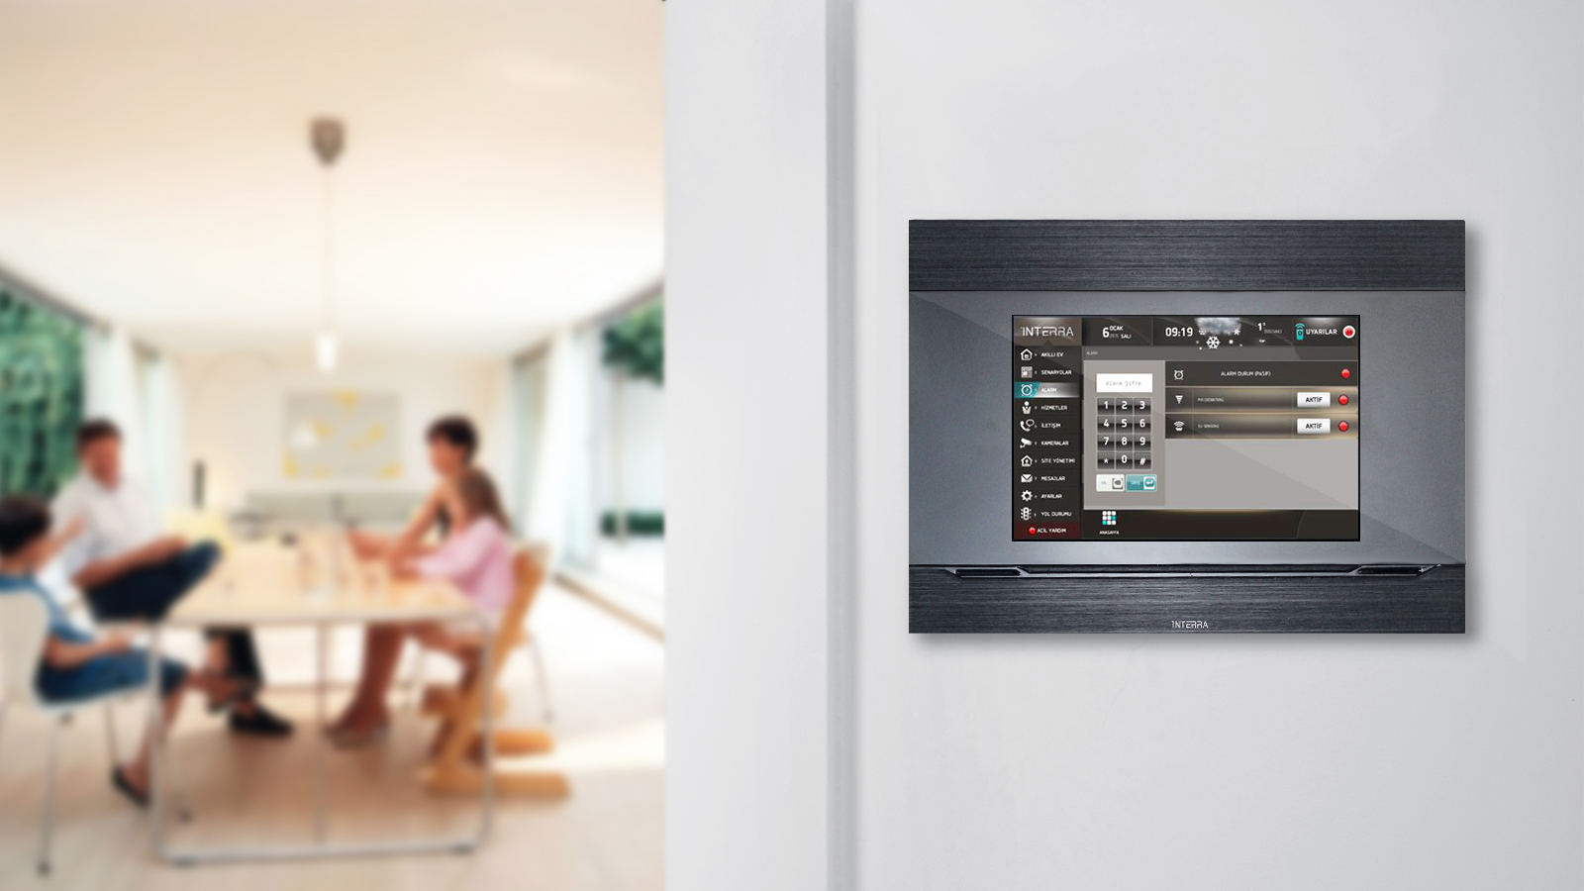
Scenario
The comfort of performing multiple controls with a single touch
Morning, Dinner, Holiday etc. designed scenarios
Via mobile devices controls of scenarios

Slide 7
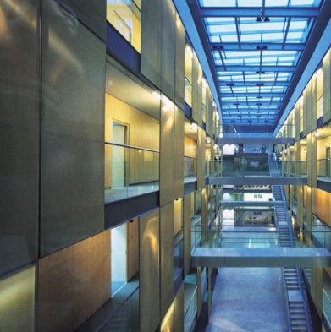
Developer of uniqueness
Lighting
Lighting solutions offer a wide range of solutions with armature-based applications, from one-room offices to thousands of rooms in commercial buildings.
The scenarios are determined by sensors, events, or users in the building
Reports battery test and fault conditions of emergency lighting fixtures in the facility.

Slide 8
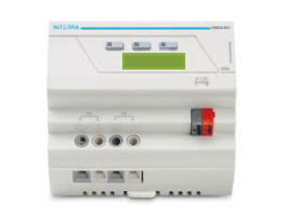
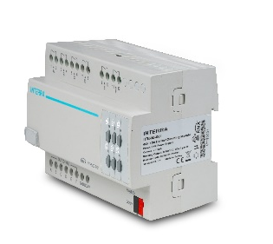
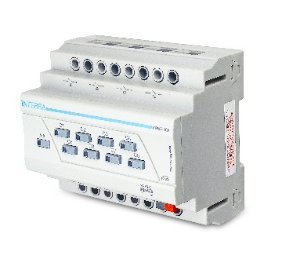
Developer of uniqueness
Lighting Control
Standart luminaires are managed as single or group with switching modules.
With Dali Gateway, you can manage and monitor dimmable and addressable lighting fixtures.
With KNX Universal Dimmer Module, incandescent, halogen and dimmable LED can control.
With DMX module, RGB, Robot Lights, Scene Devices can manage.

Slide 9
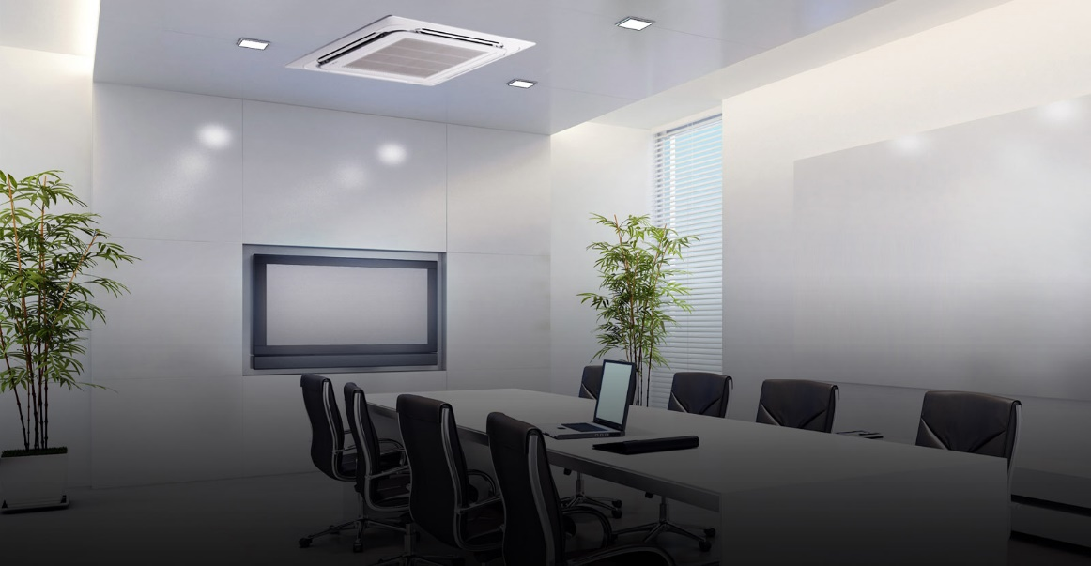
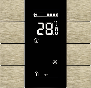
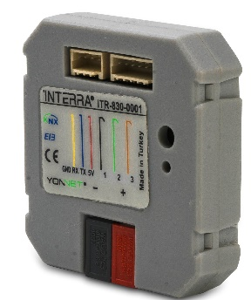
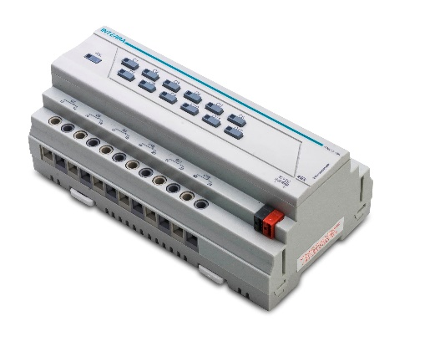
Developer of uniqueness
Air Conditioning
Fancoil control units provide Heating/Cooling monitoring and management control.
Reduction of heating in open window conditions.
ITR830, used for monitor and control Mitsubishi Electric air condition devices all function and parameters.
Central control for night scenario
Energy efficiency air conditioning control

Slide 10
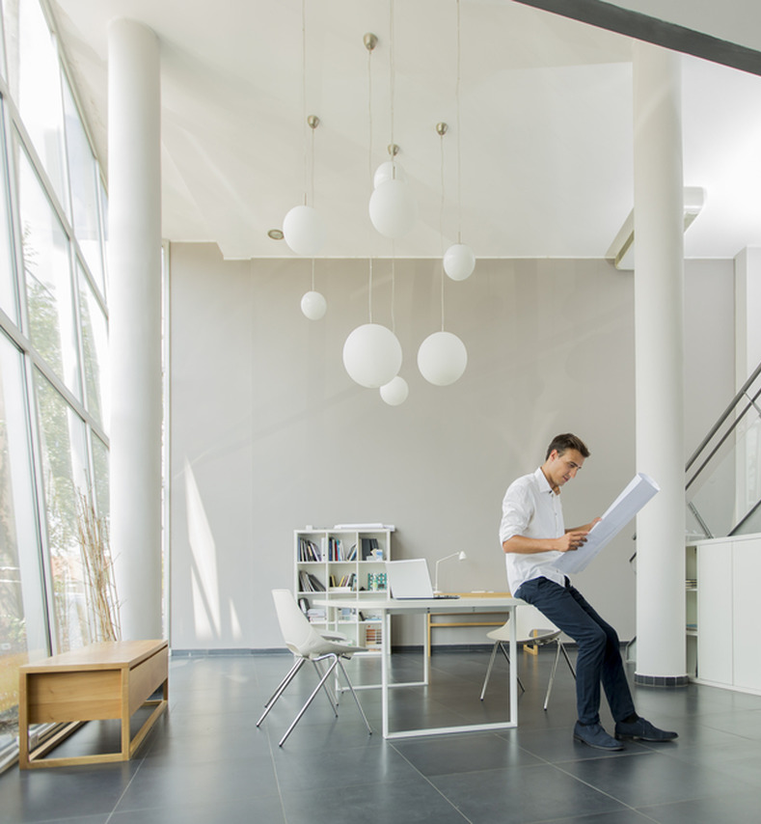
Shutter - Blind
Any type shutter-blind control
Easy control of shutter-blind by time and scenarious
Auto control of shutter-blind with brightness sensor lux value.
www.interra.com.tr

Slide 11
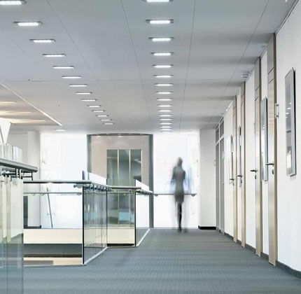
  Daylight Control
Automatically increase/decrease lighting value by on daylight changes. Specially it can be used for outdoor lighting as well as manually too.
All the places you want to have the same light level can be adjusted automatically according to the external light.
Shutter – Blind can control according to daylight.
www.interra.com.tr

Slide 12
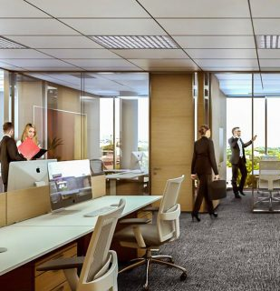
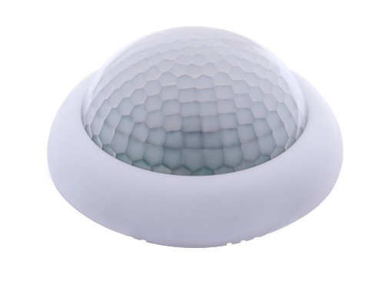
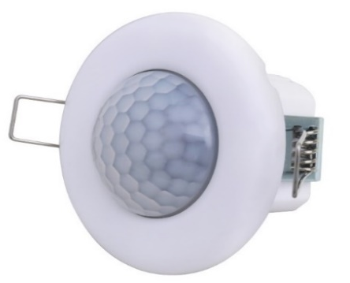
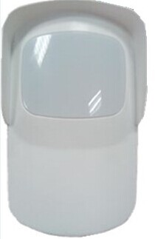
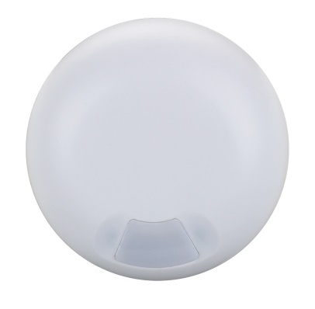
  Timeable Controls
Lighting devices can control at schedule time and specified places.
Provides to energy saving in home, office, workplace, airport, stadium and other places.
When the weather gettings dark, the lighting system in the garden and the any space you want can be illuminated automatically.
Illumination scenarious can create which suitable for working hours can be set.
Forgotten lighting fixtures can be switched of at scheduled times automatically.
www.interra.com.tr

Slide 13

Automation Control Other Features
When the door is forced by magnetic contact signal run the alarm process.
Run the alarm process with motion sensors signal.
www.interra.com.tr

Slide 14
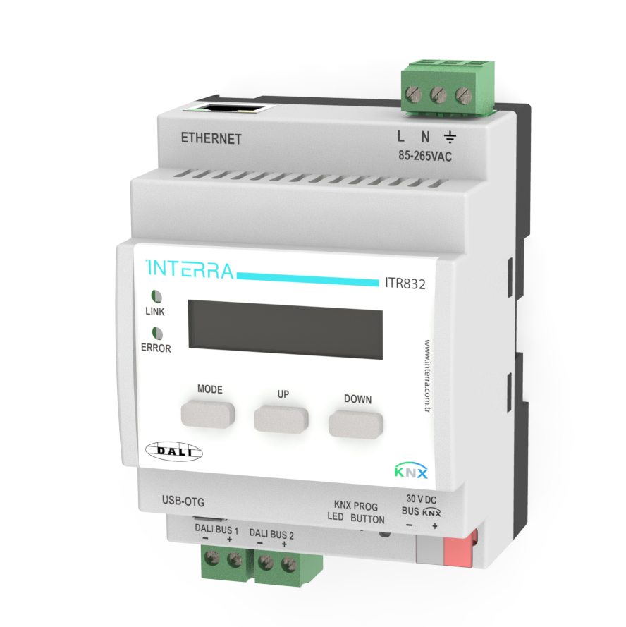
Developer of uniqueness
INTERRA DALI GATEWAY
Included Internal Dali Power Supply
DALI Gateway, support emergency lighting control.
DALI Gateway, supports DALI EN 62386-202 standard which is defining DALI emergency lighting.
DALI Gateway also supports the "Tunable White (TW)" feature and supports the luminous color control (DALI Device Type 8) according to EN 62386-209.
www.interra.com.tr

Slide 15
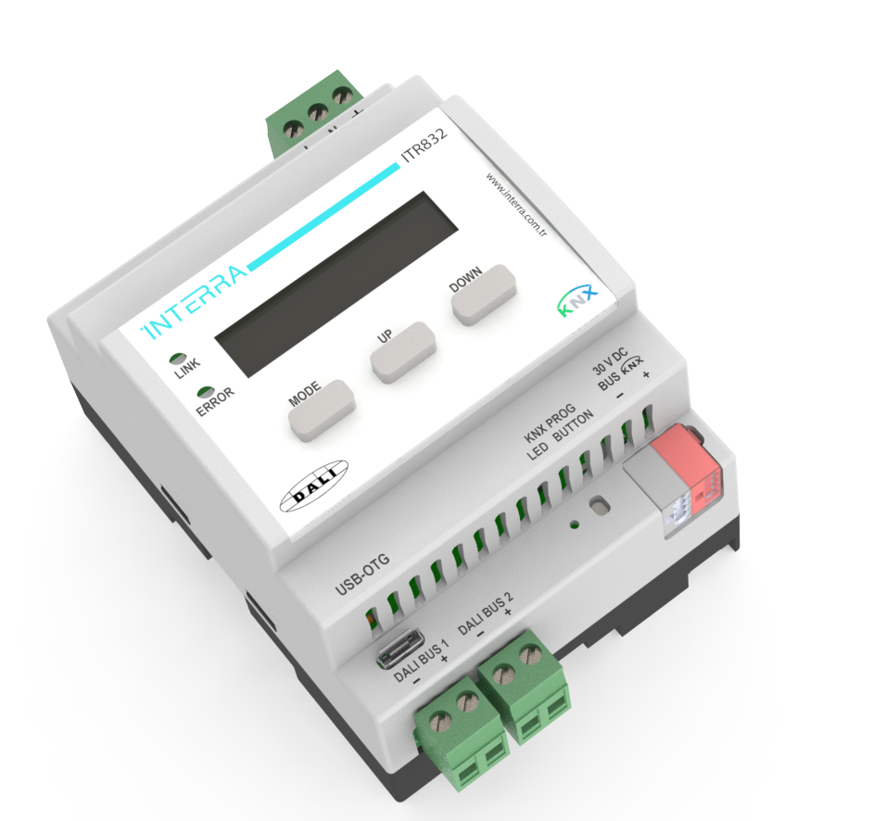
Developer of uniqueness
INTERRA DALI GATEWAY
ITR832-001 DALI Gateway (2 x DALI Line), can control 2 x 64 DALI ballasts and 2 x 16 DALI groups with one or more DALI ballasts in each.
Feedback can be obtained by providing device controls via broadcast commands.
DALI Gateway, can control 2 x 16 independent lighting scenario.
Control of the ballasts connected to the DALI Interface, can be done via the web server available on the device.
DALI Sensor and DALI Button can support.
www.interra.com.tr

Slide 16
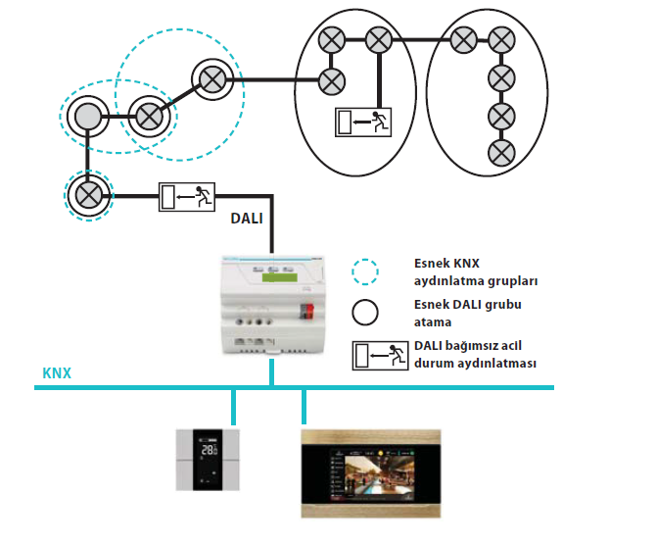
Developer of uniqueness
1 X 64 CONNECTION:
The perfect solution for all application:
- 1 DALI output till to 64 DALI balast
• 16 DALI Group
• 64 single DALI balast
• 64 Emergency Status
(EN 62386-202 self-contained emergency devices)
• 16 lighting scenario
Flexible combination at DALI output
With Single / Group / KNX ile control and monitor
www.interra.com.tr

Slide 17
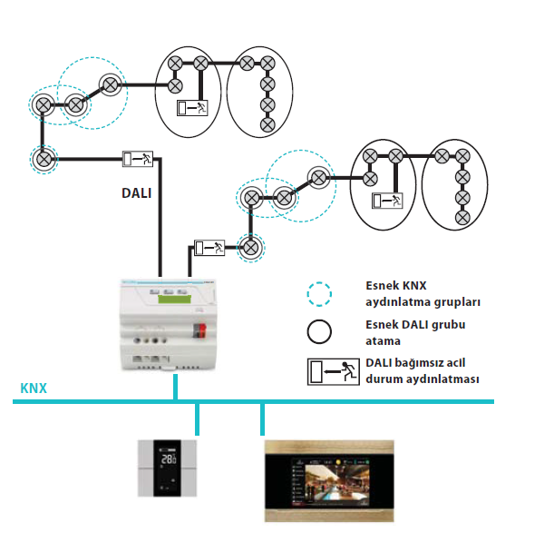
Developer of uniqueness
2 X 64 CONNECTION:
The perfect solution for all application:
- Complete and equivalent function 2x DALI output
• 2x16 flexible DALI group control
• 2x64 flexible DALI single control
• 2x 64 independent emergency lighting control
(DALI standard EN 62386-202 Type 1)
• 2x16 lighting scenario
Flexible combination at 2x DALI output
With Single / Group / KNX ile control and monitor
www.interra.com.tr

Slide 18
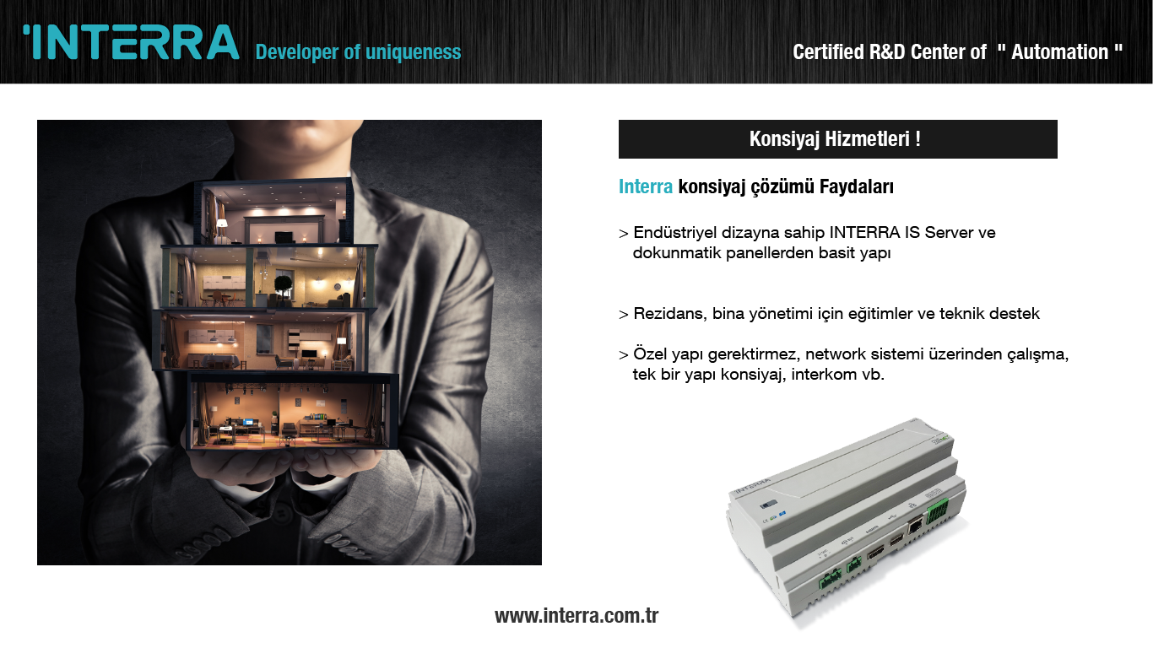
Developer of uniqueness
FONKSİYONLAR
Auto Dali Addressing
Switching, Dimming, Tunable White
Staircase function
Burn-in
Scenario
Forced Positioning
Emergency Lighting Testing
KNX Bus Voltage Fault Status
Ballast and/or Light Faulty
Tunable White dimming with Scenarious
Visualization wth Web Server
Presence sensor connection via DALI Line (v2)
DALI Button connection via DALI Line (v2)
DayLight sensor connection via DALI Line(v2)
www.interra.com.tr

Slide 19
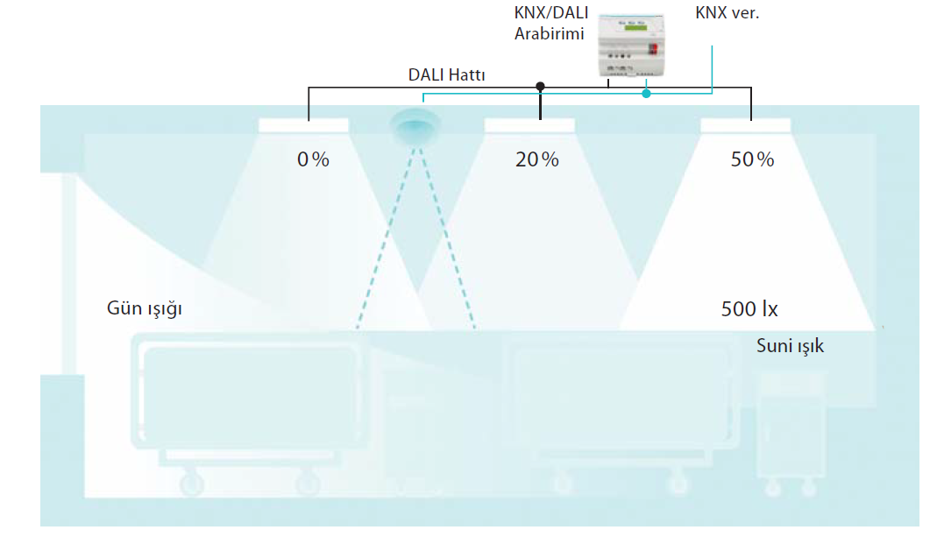
Developer of uniqueness
SAMPLE PROJECT DESIGN
Hospital Project Example:
Central monitoring of the hospitals or buildings reduces staff costs. In order to reduce energy costs, energy consumption data can be collected for analysis, maximum loads can be closed and consumers that are not already needed can be closed.
For example, in peak periods, the outputs from the air conditioning system can be temporarily reduced in some areas.
Operating costs can be reduced by prioritizing maintenance and repair according to need.
This can be achieved, for example, from DALI-ECGs, as well as fault reports, by counting the working hours, switching cycles.
www.interra.com.tr

Slide 20
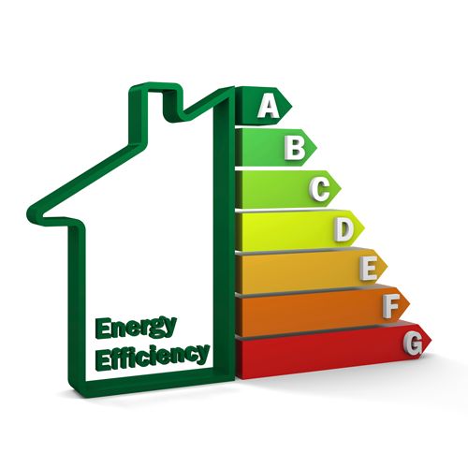
Developer of uniqueness
ECONOMY
Using daylight without reflection
Constant brightness setting
Presence Lighting
Heating, cooling and ventilation as required
Reduction of heating in case of open window
‘’Central closing’’ for night heating
Effective building management with visualization
Maintenance as required
Closing the needless energy consumers / devices
www.interra.com.tr

Slide 21
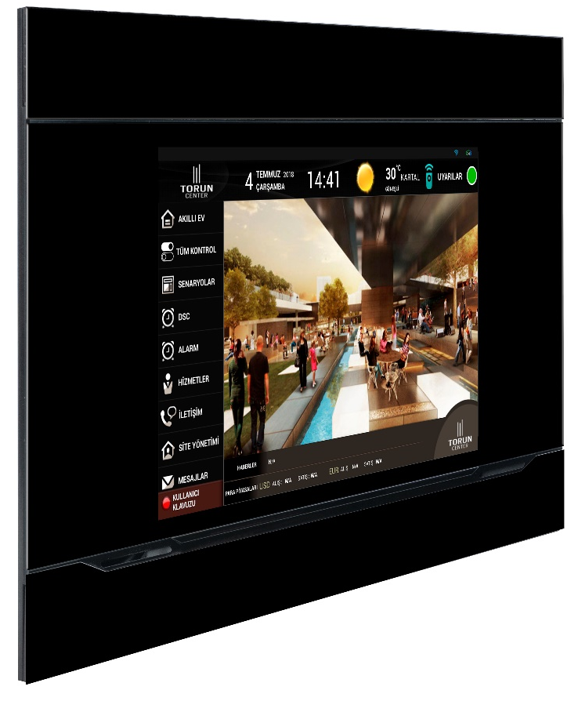
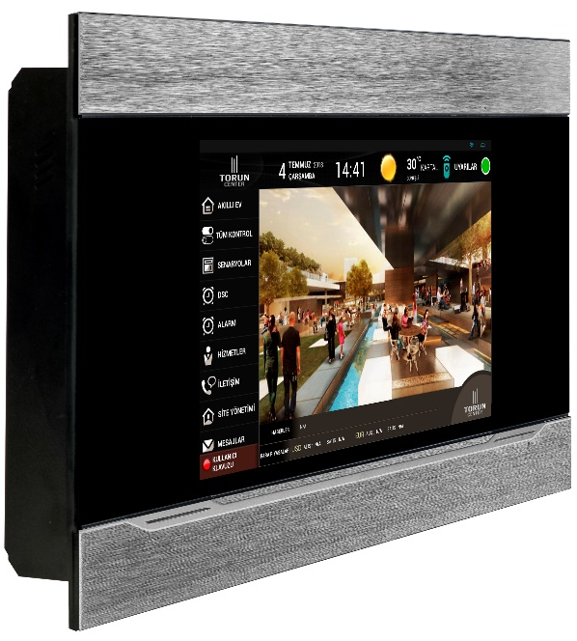
Developer of uniqueness
INTERRA TOUCH PANEL
Easily control video intercom, lights, heating system, jalousie blinds and alarm system with the help of a single control screen.
"10" Touch Panel
"7" Touch Panel
www.interra.com.tr

Slide 22
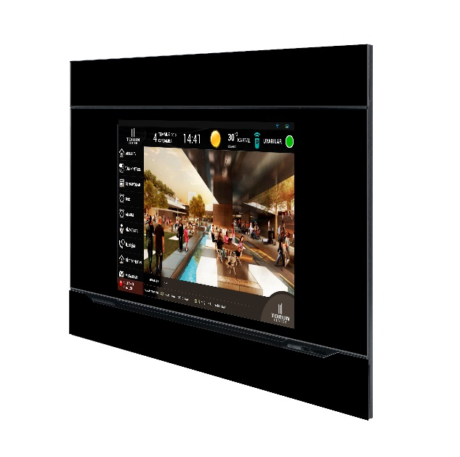
Developer of uniqueness
You can inspire your living spaces by controlling curtains and blinds through the touch panel.
Timing management; Daily, weekly, monthly or special schedule programs and automatic controls are provided.
INTERRA TOUCH PANEL
Lighting
Shutter / Blind
HVAC
Camera
Timer
Security
Unused systems are no longer a reason for unnecessary energy consumption. With Interra air conditioning solutions you can determine the effective running time of the heating-cooling functions.
Security systems can be controlled via mobile and dashboard applications and can be viewed with existing cameras.
In case of danger, message is provided.

Slide 23
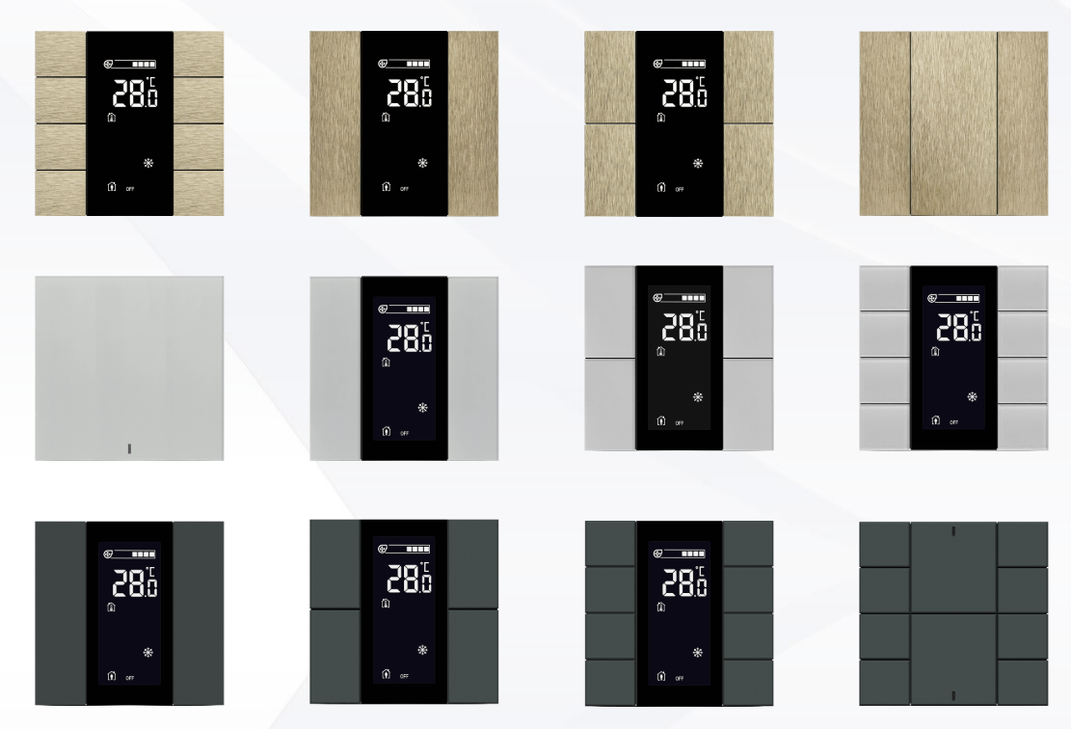
Developer of uniqueness
INTERRA ISWITCH
Integrated temperature and humidity sensors automatically control the fields.Enerjisini KNX BUS hattından alan cihaz çok az enerji tüketiyor.
Room Controller
Lighting
Shutter/Blind
HVAC
Thermostat
www.interra.com.tr

Slide 24
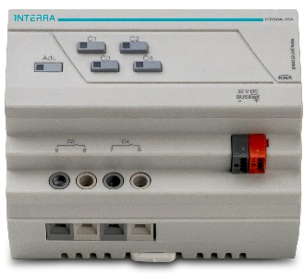
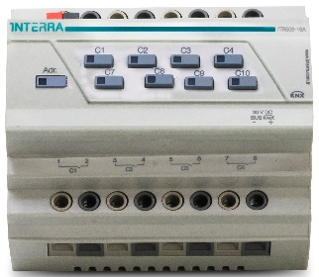
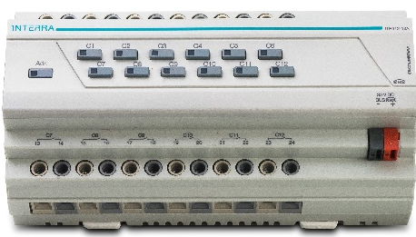
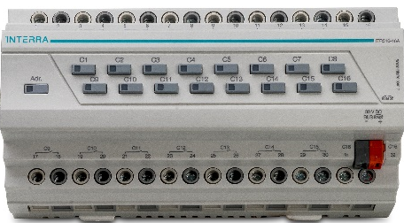
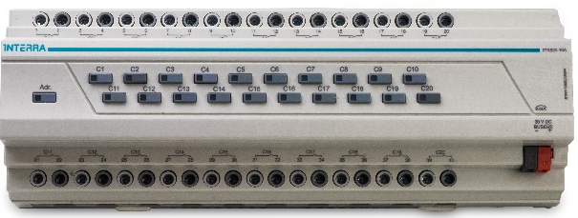
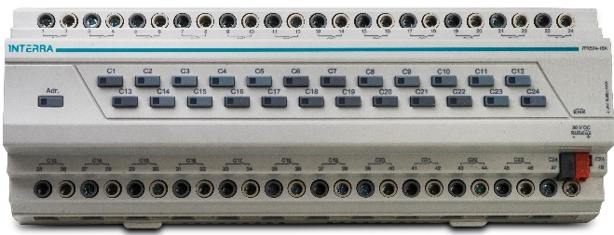
Developer of uniqueness
INTERRA KNX COMBO
Control all system with 1 combo device;
Lighting
Shutter – Blind
FCU
6 different sizes between 4 and 24 channels; 4,8,12,16,20,24 channel combo provides you project efficiency.
www.interra.com.tr

Slide 25
Developer of uniqueness
SENSORS
KNX Motion Sensor
KNX Microwave Sensor
KNX LUX Sensor
Whether external lighting or interior lighting is controlled in relation to daylight controls.
Controlling lighting and air-conditioning devices with motion-sensitive sensors.

Slide 26
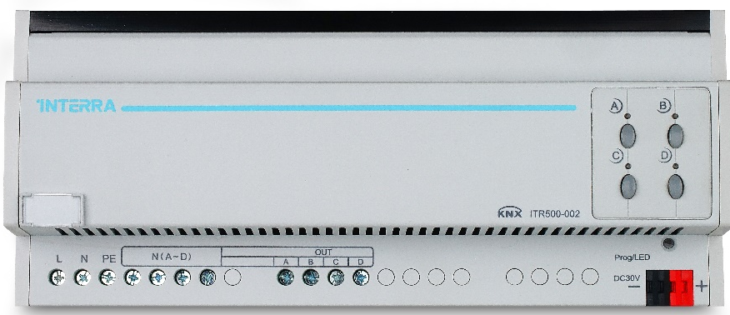
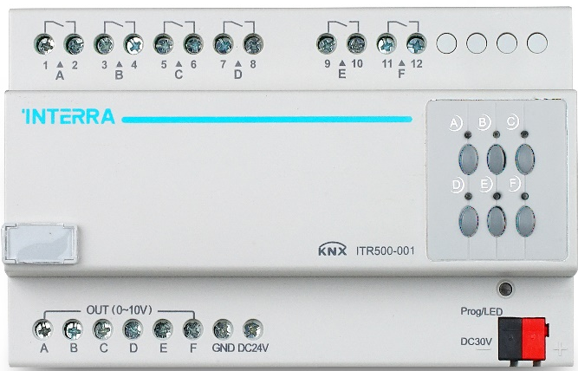
Developer of uniqueness
INTERRA DIMMING MODULE
ITR500-002, 4 channels, each channel has 1.5A capacity dimming.
As Leading Edge or Trailing Edge dimming can be used.
ITR500-001, Each channel 0-10V with the ballast can do over the method of dimming.
For each channel there is a 10A current carrying value relay and can also be controlled manually.
www.interra.com.tr

Slide 27
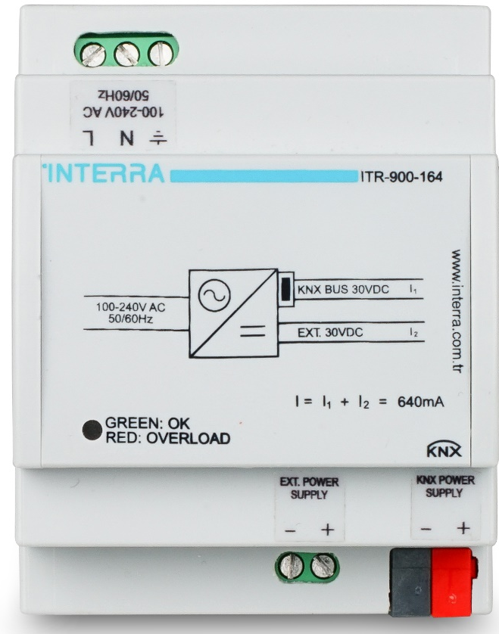
Developer of uniqueness
KNX GÜÇ KAYNAĞI
KNX power supplies produce voltage for the KNX system. (SELF) The KNX line is separated from the power supply by means of an insulated coil. The voltage output is protected against short circuit and overload. Indicates the device output status with two-color LED. It has an external 30VDC output.
Power Supply, 160 Ma
Power Supply, 320 mA
Power Supply, 640 mA
www.interra.com.tr

Slide 28
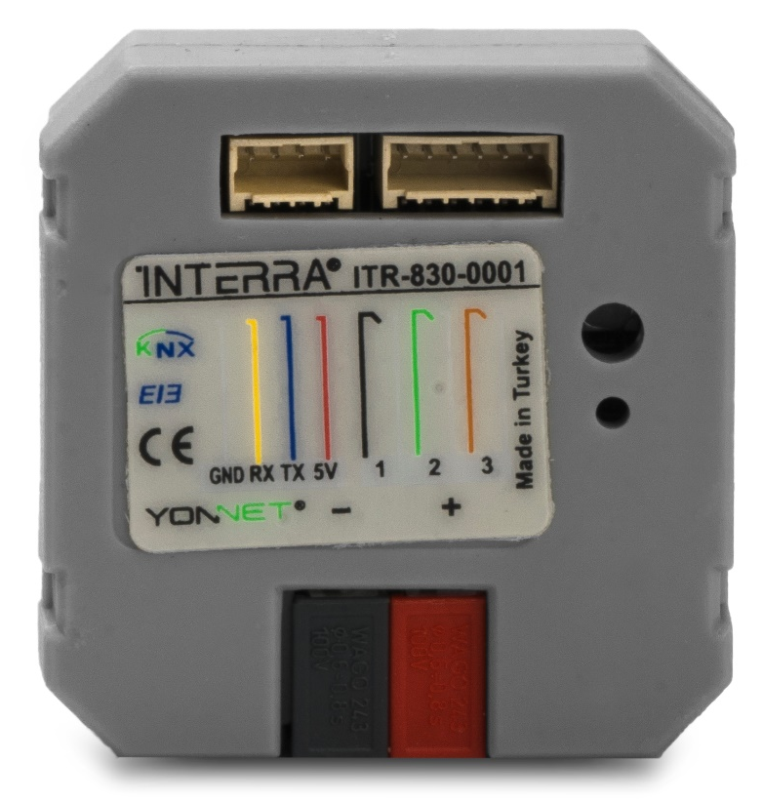
Developer of uniqueness
MITSUBISHI ELECTRIC KNX GATEWAY
Provides full integration of Mitsubishi Electric AC with KNX bus.
It provides full two-way integration (control and monitoring) between the AC indoor unit and the KNX.
Provides 3 different digital inputs (etc Motion detector, drain pump, push button) to integrate into KNX.
www.interra.com.tr

Slide 29
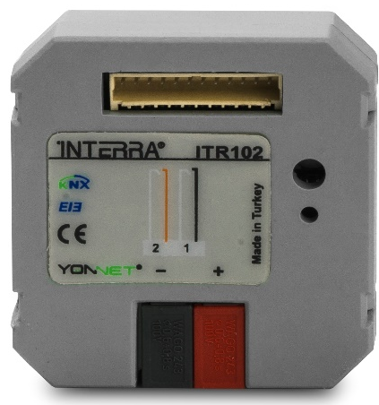
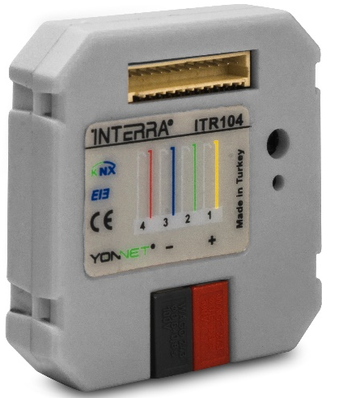
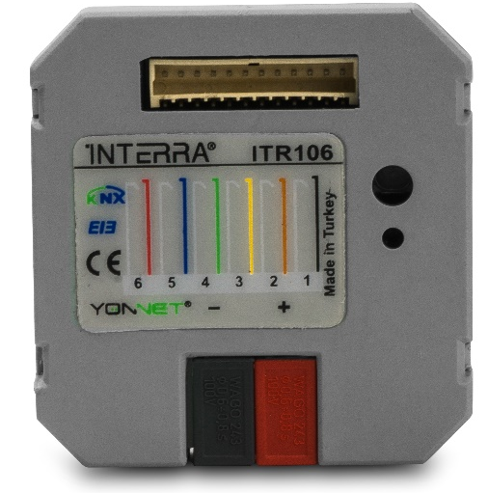
Developer of uniqueness
INTERRA PUSH BUTTON INTERFACE
It is capable of converting the contact signal to any KNX signal.
2-gang
4-gang
6-gang
The input module is placed in the standard electrical box of the switch or socket. And it helps provide KNX controls over traditional switches.
www.interra.com.tr

Slide 30
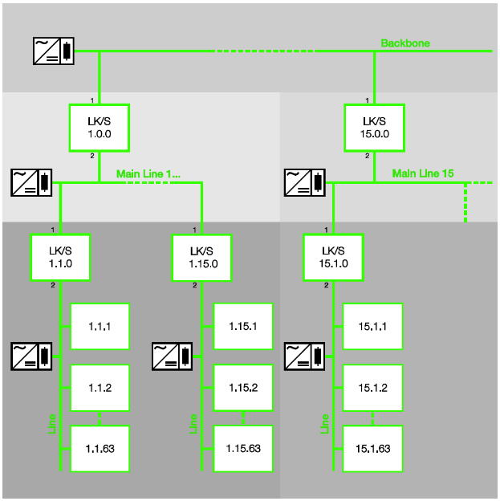
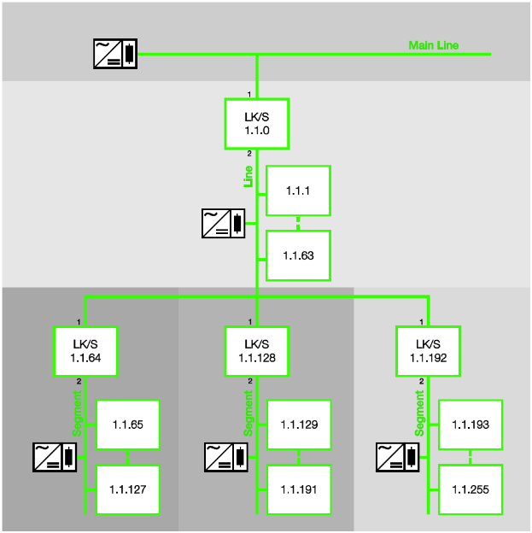
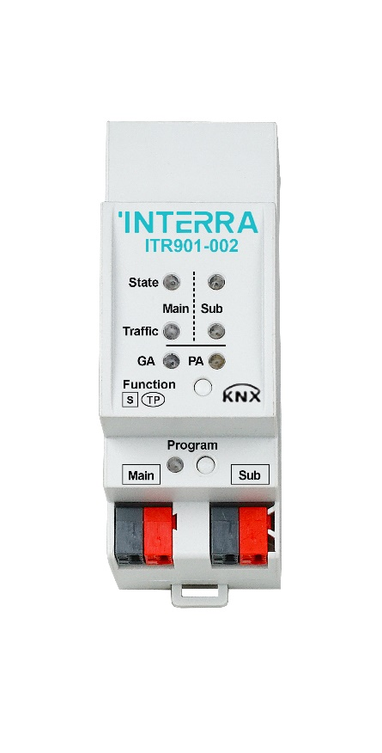
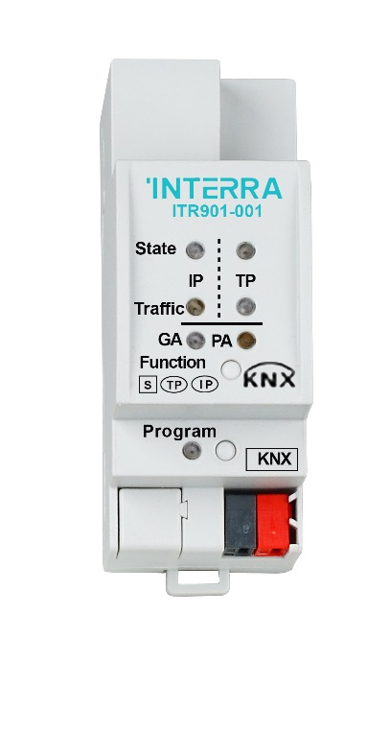
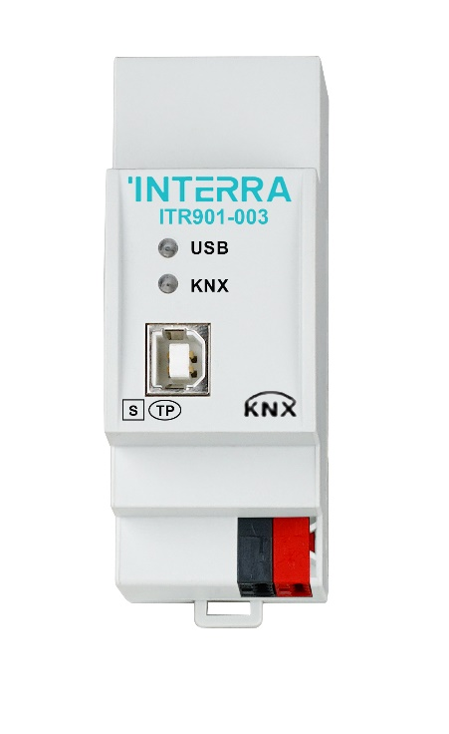
Developer of uniqueness
INTERRA SYSTEM COMPANENTS
Standard Application
KNX IP ROUTER
KNX LINE COUPLER
KNX USB INTERFACE
Line Coupler
Line Repeater

Slide 31
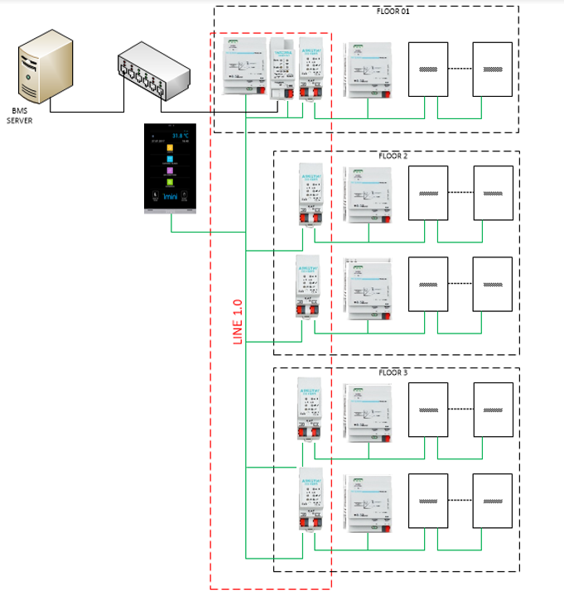
Developer of uniqueness
Topology with Twisted Pair:
Program and monitor the devices at each point.
All in the same ETS Project.
The ETS group deals with the limitation in large projects.
High bus load if centralized visualization or BMS is used.

Slide 32
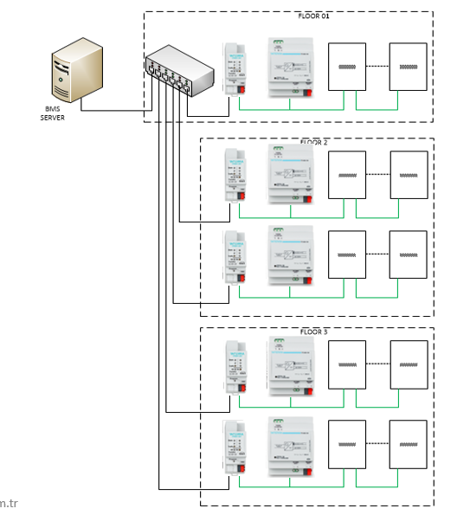
Developer of uniqueness
Topology with IP'si:
One ETS Project for similar areas.
Reduce the bus load if you are using central visualization or BMS.
www.interra.com.tr

Slide 33

Developer of uniqueness
Topology Mixed TP-IP:
Public areas operate over TP or IP.
Use the same ETS Project for similar areas.
Reduce bus load if you are using central visualization or BMS.

Slide 34

Developer of uniqueness
EMERGENCY LIGHTING
Batteries and operating times of emergency lighting fixtures and exit signs can be monitored, reported.
Fault information can be displayed if emergency sign is faulty.
Can test and reported.
www.interra.com.tr

Slide 35





Developer of uniqueness
CENTRAL CONTROL
Control
Monitoring
Analysis
Easy Reporting
Scene Creation
Integration with 3rd part system solutions
Error and information messages
Communicating with other systems within the building on common platform and monitoring from the center is an important feature of the future buildings.

Slide 36

Developer of uniqueness
INTERRA REMOTE CONTROL
Remote control on mobile and tablets
Simple desing
Full control for automation and services
Fast and Secure Communication

Slide 37

Developer of uniqueness
ACİL DURUMLAR
Information is automatically received when an emergency occurs. The previously defined emergency scenario is executed and the related units are informed.
www.interra.com.tr

Slide 38

INTERRA COMMERCIAL AND INDUSTRIAL BUILDING SOLUTIONS
Developer of uniqueness

